Slide 1

Web Page Designing- HTML, CSS and XML
By Prof Vaibhavi Patel

Slide 2
Content
HTML:HTML elements, Attributes, HTML Formatting list, table, images, iframe ,forms, HTML Classes, ID, HTML Links, HTML Graphics, HTML Media.
CSS: Types of CSS, Color, Background, Border, List, Tables, CSS Pseudo Classes, CSS Border Image, CSS Box Model, CSS Text Effects, CSS 2D Transforms, CSS 3D Transforms, CSS Animation, CSS User Interface.
XML: Introduction to XML, XML Tree, XML DTD, XML Schema.

Slide 3
HTML
Hyper Text Markup Language

Slide 4
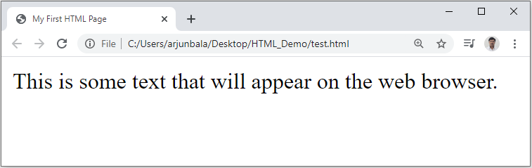
First HTML Page
test.html
<!DOCTYPE HTML>
<html>
<head>
<title>My First HTML Page</title>
</head>
<body>
<p>This is some text...</p>
</body>
</html>

Slide 5
Introduction
HTML is comprised of “elements” and “tags”
Begins with <html> and ends with </html>
Elements (tags) are nested one inside another:
HTML describes structure using two main sections: <head> and <body>
Tags have attributes:
<html> <head></head> <body></body> </html>
<img src="logo.jpg" alt="logo" />

Slide 6
HTML Attributes
All HTML elements can have attributes
Attributes provide additional information about an element
Attributes are always specified in the start tag
Attributes usually come in name/value pairs like: name="value“
For example:
<a href="https://www.google.com">This is a link</a>
<img src="img_girl.jpg" width="500" height="600">

Slide 7
First HTML Page
HTML header
<!DOCTYPE HTML>
<html>
<head>
<title>My First HTML Page</title>
</head>
<body>
<p>This is some text...</p>
</body>
</html>
Opening tag
Closing tag
HTML body

Slide 8
HTML Formatting Elements
<b> - Bold text
<strong> - Important text
<i> - Italic text
<mark> - Marked text
<small> - Small text
<big> - big text
<del> - Deleted text : defines deleted (removed) text
<sub> - Subscript text
<sup> - Superscript text
<u> - underlined text
Notes:
Browsers display <strong> as <b>, and <em> as <i>. However, there is a difference in the meaning of these tags: <b> and <i> defines bold and italic text, but <strong> and <em> means that the text is "important".

Slide 9
HTML Formatting Elements
<pre> - defines preformatted text, text preserves both spaces and line breaks. The text will be displayed exactly as written in the HTML source code.
<code> - defines a piece of computer code, is used to define a piece of computer code. The content inside is displayed in the browser's default monospace font.
<bdo> - Bi-Directional Override, is used to override the current text direction, Attribute is dir and Values are ltr and rtl.
Notes:
Notice that the <code> element does not preserve extra whitespace and line-breaks.
To fix this, you can put the <code> element inside a <pre> element:

Slide 10
HTML Tables
An HTML table is defined with the <table> tag.
Each table row is defined with the <tr> tag.
A table header is defined with the <th> tag. By default, table headings are bold and centered.
A table data/cell is defined with the <td> tag.
To make a cell span more than one column, use the colspan attribute
To make a cell span more than one row, use the rowspan attribute
The <caption> tag defines a table caption.
The <caption> tag must be inserted immediately after the <table> tag.

Slide 11
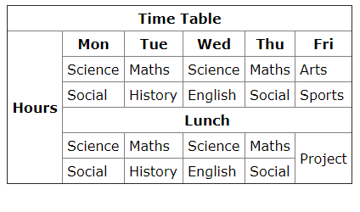
Example

Slide 12
HTML <hr> Tag
The <hr> element is most often displayed as a horizontal rule that is used to separate content (or define a change) in an HTML page.
HTML <br> Tag
The <br> tag inserts a single line break.
The <br> tag is an empty tag which means that it has no end tag.
Notes:
Note: Use the <br> tag to enter line breaks, not to add space between paragraphs.

Slide 13
HTML <abbr> Tag
The <abbr> tag defines an abbreviation or an acronym, like "HTML", "CSS", "Mr.", "ASAP”.
Use the title attribute to show the description for the abbreviation when you mouse over the element.
HTML<iframe> Tag
The <iframe> tag specifies an inline frame.
An inline frame is used to embed another document within the current HTML document.
Src attribute Specifies the address of the document to embed in the <iframe>
An iframe can be used as the target frame for a link.
The target attribute of the link must refer to the name attribute of the iframe:
Notes:
Without video tag how to add YouTube video??

Slide 14
HTML Entities
Some characters are reserved in HTML.
If you use the less than (<) or greater than (>) signs in your text, the browser might mix them with tags.
Character entities are used to display reserved characters in HTML.
A character entity looks like this:
&entity_name;
OR
&#entity_number;

Slide 15
Some Useful HTML Character Entities
Result | Description | Entity Name
 | non-breaking space | &nbsp;
< | less than | &lt;
> | greater than | &gt;
& | ampersand | &amp;
" | double quotation mark | &quot;
' | single quotatioan mark (apostrophe) | &apos;
© | copyright | &copy;
µ | micro | &micro;
× | multiplication | &times;
÷ | division | &divide;
Θ | Big Theta | &Theta;
θ | Small theta | &theta;
Φ | Phi | &Phi;
Notes:
Note: Entity names are case sensitive.

Slide 16
Some Useful HTML Character Entities
Result | Description | Entity Name
α | alpha | &alpha;
β | beta | &beta;
λ | lambda | &lambda;
μ | mu | &mu;
ρ | rho | &rho;
σ | sigma | &sigma;
τ | tau | &tau;
µ | micro | micro
Π | Pi | &Pi;
Notes:
Note: Entity names are case sensitive.

Slide 17
HTML Comment Tags
<!-- Write your comments here -->
<!-- Do not display this at the moment <img border="0" src="pic_trulli.jpg" alt="Trulli"> -->
Notes:
HTML comments are not displayed in the browser
With comments you can place notifications and reminders in your HTML code:
Comments can be used to hide content.

Slide 18
HTML Links - Hyperlinks
- HTML links are hyperlinks.
You can click on a link and jump to another document.
When you move the mouse over a link, the mouse arrow will turn into a little hand.
<a href="url">link text</a>

Slide 19
Cont..
For example:
<a href="https://www.google.com/" target="_blank">Visit google!</a>
The target attribute specifies where to open the linked document.
The target attribute can have following values:
_blank - Opens the linked document in a new window or tab
_self - Opens the linked document in the same window/tab as it was clicked (this is default)

Slide 20
Bookmark
HTML links can be used to create bookmarks, so that readers can jump to specific parts of a web page.
Bookmarks can be useful if a web page is very long.
To create a bookmark - first create the bookmark, then add a link to it.
When the link is clicked, the page will scroll down or up to the location with the bookmark.
We can also add a link to a bookmark on another page

Slide 21
HTML Images
Images can improve the design and the appearance of a web page.
In HTML, images are defined with the <img> tag.
The <img> tag is empty, it contains attributes only, and does not have a closing tag.
The src attribute specifies the URL (web address) of the image:
For example:
<img src=“logo.jpg" alt=“logo of NUV">
Notes:
The alt attribute provides an alternate text for an image, if the user for some reason cannot view it (because of slow connection, an error in the src attribute).
If a browser cannot find an image, it will display the value of the alt attribute

Slide 22
HTML Links - Image as Link
<!DOCTYPE html>
<html>
<body>
<h2>Image Links</h2>
<p>The image is a link. You can click on it.</p>
<a href="https://nuv.ac.in/">
<img src="logo.jpg“ alt=“Nuv site">
</a>
</body>
</html>

Slide 23
HTML List
Unordered HTML List
Ordered HTML List
HTML Description Lists

Slide 24
HTML List-Unordered HTML List
An unordered list starts with the <ul> tag. Each list item starts with the <li> tag.
The list items will be marked with bullets (small black circles) by default
Notes:
Type arribute:
Circle Sets the list item marker to a circle
Square Sets the list item marker to a square
None The list items will not be marked

Slide 25
HTML List-Ordered HTML List
An ordered list starts with the <ol> tag. Each list item starts with the <li> tag.
The list items will be marked with numbers by default
The type attribute of the <ol> tag, defines the type of the list item marker
Notes:
type="1“ The list items will be numbered with numbers (default)
type="A“ The list items will be numbered with uppercase letters
type="a“ The list items will be numbered with lowercase letters
type="I“ The list items will be numbered with uppercase roman numbers
type="i“ The list items will be numbered with lowercase roman numbers

Slide 26
HTML List-Description HTML List
A description list is a list of terms, with a description of each term.
The <dl> tag defines the description list, the <dt> tag defines the term (name), and the <dd> tag describes each term

Slide 27
HTML Graphics - SVG
SVG stands for Scalable Vector Graphics
SVG is used to define graphics for the Web
Every element and every attribute in SVG files can be animated
SVG images can be printed with high quality at any resolution
SVG graphics do NOT lose any quality if they are zoomed or resized
The HTML <svg> element is a container for SVG graphics.

Slide 28
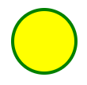
SVG Circle
<!DOCTYPE html>
<html>
<body>
<svg>
<circle cx="50" cy="50" r="40"
stroke="green" stroke-width= "5" fill= "blue" />
Sorry, your browser does not support inline SVG.
</svg>
</body>
</html>

Slide 29
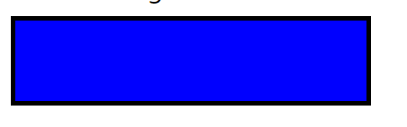
SVG Rectangle
<svg> <rect width="400" height="100" stroke="green" stroke-width= "5" fill= "blue" /> </svg>

Slide 30
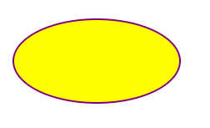
SVG Ellipse - <ellipse>
An ellipse is closely related to a circle. The difference is that an ellipse has an x and a y radius that differs from each other, while a circle has equal x and y radius:
<ellipse cx="200" cy="80" rx="100" ry="50" stroke="green" stroke-width= "5" fill= "blue" />
The cx and cy attributes define the x and y coordinates of the center of the ellipse
The rx attribute defines the horizontal radius
The ry attribute defines the vertical radius

Slide 31
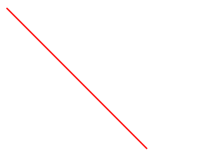
SVG Line - <line>
The <line> element is used to create a line:
<line x1="0" y1="0" x2="200" y2="200" stroke="green" stroke-width= "5" fill= "blue" />

Slide 32
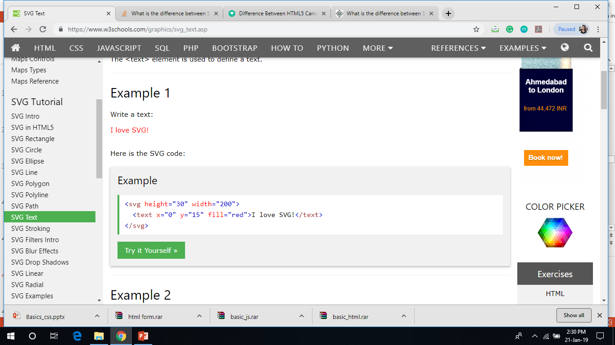
SVG Text - <text>
The <text> element is used to define a text.
<text x="0" y="15" fill="red">I love SVG!</text>

Slide 33
Multimedia
Multimedia comes in many different formats. It can be almost anything you can hear or see.
Multimedia elements (like audio or video) are stored in media files.
The most common way to discover the type of a file, is to look at the file extension. Multimedia files have formats and different extensions like: .swf, .wav, .mp3, .mp4, .mpg, .wmv, and .avi.
Only MP4, WebM, and Ogg video are supported by the HTML5 standard.
Only MP3, WAV, and Ogg audio are supported by the HTML5 standard.

Slide 34
Audio
The HTML5 <audio> element specifies a standard way to embed audio in a web page.
<audio controls> <source src="horse.ogg" type="audio/ogg"> <source src="horse.mp3" type="audio/mpeg"> Your browser does not support the audio element. </audio>
The controls attribute adds audio controls, like play, pause, and volume.
The <source> element allows you to specify alternative audio files which the browser may choose from. The browser will use the first recognized format.
The text between the <audio> and </audio> tags will only be displayed in browsers that do not support the <audio> element.

Slide 35
Video
The HTML <video> element is used to show a video on a web page.
The controls attribute adds video controls, like play, pause, and volume.
It is a good idea to always include width and height attributes.
The <source> element allows you to specify video file.
Add muted and autoplay to let video start playing automatically (but muted)
<video width="320" height="240" controls>
<source src=“temp.mp4" type="video/mp4">
<source src=“temp.ogg" type="video/ogg">
Your browser does not support the video tag.
</video>

Slide 36
HTML <meta> Tag
The <meta> tag defines metadata about an HTML document. Metadata is data (information) about data.
<meta> tags always go inside the <head> element, and are typically used to specify character set, page description, keywords, author of the document, and viewport settings.
Metadata will not be displayed on the page.
Metadata is used by browsers (how to display content or reload page), search engines (keywords), and other web services.

Slide 37
HTML <meta> Tag-example
Define keywords for search engines:
<meta name="keywords" content="HTML, CSS, JavaScript">
Define a description of your web page:
<meta name="description" content="Free Web tutorials for HTML and CSS">
Define the author of a page:
<meta name="author" content="John Doe">
Refresh document every 30 seconds:
<meta http-equiv="refresh" content="30">
Setting the viewport to make your website look good on all devices:
<meta name="viewport" content="width=device-width, initial-scale=1.0">
Notes:
The viewport is the user's visible area of a web page. It varies with the device - it will be smaller on a mobile phone than on a computer screen.
This gives the browser instructions on how to control the page's dimensions and scaling.
The width=device-width part sets the width of the page to follow the screen-width of the device (which will vary depending on the device).
The initial-scale=1.0 part sets the initial zoom level when the page is first loaded by the browser.

Slide 38
The <form> Element
The HTML <form> element defines a form that is used to collect user input.
The user input is most often sent to a server for processing.
<form> . form elements . </form>
The <form> element is a container for different types of input elements, such as: text fields, checkboxes, radio buttons, submit buttons, etc.

Slide 39
Form attributes
Action attribute
Method attribute
<form action= "temp.php" method="get" >
Notes:
The action attribute defines the action to be performed when the form is submitted. Usually, the form data is sent to a file on the server when the user clicks on the submit button.
Get:
Appends the form data to the URL, in name/value pairs
NEVER use GET to send sensitive data! (the submitted form data is visible in the URL!)
. The length of a URL is limited (about 3000 characters)
POST:
has no size limitations, and can be used to send large amounts of data.
Appends the form data inside the body of the HTTP request (the submitted form data is not shown in the URL)

Slide 40
Form Elements

Slide 41
The <input> Element
The most important form element is the <input> element.
The <input> element can be displayed in several ways, depending on the type attribute.
If the type attribute is omitted, the input field gets the default type: "text"

Slide 42
HTML Input Types
Input Type Text
<input type="text"> defines a one-line text input field
Input Type Password
<input type="password"> defines a password field
Input Type Submit
<input type="submit"> defines a button for submitting form data to a form-handler.
Input Type Reset
<input type="reset"> defines a reset button that will reset all form values to their default values:

Slide 43
HTML Input Types
Input Type Radio
<input type="radio"> defines a radio button.
Radio buttons let a user select ONLY ONE of a limited number of choice
<form> <input type="radio" name="gender" value="male" checked> Male<br> <input type="radio" name="gender" value="female"> Female<br> <input type="radio" name="gender" value="other"> Other </form>

Slide 44
HTML Input Types
Input Type Checkbox
<input type="checkbox"> defines a checkbox.
Checkboxes let a user select ZERO or MORE options of a limited number of choices.
<form> Hobbies: <input type="checkbox" name="h1" value="dance"> Dance <br> <input type="checkbox" name="h2" value="singing"> Singing </form>

Slide 45
HTML Input Types
Input Type File
The <input type="file"> defines a file-select field and a "Browse" button for file uploads.

Slide 46
HTML5 Input Types
color
date
datetime-local
month
Time
week
email
Number
range
url

Slide 47
Input Restrictions
Attribute | Description
disabled | Specifies that an input field should be disabled
Max | Specifies the maximum value for an input field
maxlength | Specifies the maximum number of character for an input field
min | Specifies the minimum value for an input field
readonly | Specifies that an input field is read only (cannot be changed)
required | Specifies that an input field is required (must be filled out)
size | Specifies the width (in characters) of an input field
value | Specifies the default value for an input field
multiple | The input multiple attribute specifies that the user is allowed to enter more than one value in an input field.
Notes:
Minlength and minlength: If the value of the type attribute is text, email, search, password, or url, this attribute specifies the maximum number of characters (in Unicode code points) that the user can enter; for other control types, it is ignored.
A read-only input field cannot be modified (however, a user can tab to it, highlight it, and copy the text from it). The value of a read-only input field will be sent when submitting the form!
A disabled input field is unusable and un-clickable. The value of a disabled input field will not be sent when submitting the form!
The min and max attributes work with the following input types: number, range, date, datetime-local, month, time and week.
The multiple attribute works with the following input types: email, and file.

Slide 48
HTML Input Attributes
The value Attribute: The value attribute specifies the initial value for an input field
The Name Attribute: Each input field must have a name attribute to be submitted. If the name attribute is omitted, the data of that input field will not be sent at all.
The autofocus Attribute: The autofocus attribute specifies that the input field should automatically get focus when the page loads.
autocomplete Attribute: The autocomplete attribute specifies whether a form or input field should have autocomplete on or off.
<form action="/action_page.php" autocomplete="on"> First name:<input type="text" name="fname"><br> Last name: <input type="text" name="lname"><br> E-mail: <input type="email" name="email" autocomplete="off"><br> <input type="submit"> </form>
Notes:
Autocomplete allows the browser to predict the value. When a user starts to type in a field, the browser should display options to fill in the field, based on earlier typed values.

Slide 49
HTML Input Attributes
The placeholder Attribute: The placeholder attribute specifies a hint that describes the expected value of an input field (a sample value or a short description of the format).
The novalidate Attribute: The novalidate attribute is a <form> attribute. When present, novalidate specifies that the form data should not be validated when submitted.

Slide 50























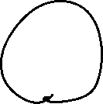

HTML5 Form Elements: <datalist> Element
The <datalist> element specifies a list of pre-defined options for an <input> element.
Users will see a drop-down list of the pre-defined options as they input data.
The list attribute of the <input> element, must refer to the id attribute of the <datalist> element.

Slide 51
<fieldset> element
The <fieldset> element is used to group related data in a form.
The <legend> element defines a caption for the <fieldset> element.

Slide 52







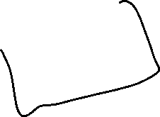










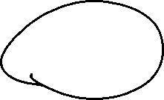

The <select> Element
The <select> element defines a drop-down list:
By default, the first item in the drop-down list is selected. To define a pre-selected option, add the selected attribute to the option
Use the size attribute to specify the number of visible.
Use the multiple attribute to allow the user to select more than one value

Slide 53
The <textarea> Element
The <textarea> element defines a multi-line input field (a text area)
The rows attribute specifies the visible number of lines in a text area.
The cols attribute specifies the visible width of a text area.

Slide 54
The <label> Element
The <label> element defines a label for the form elements.
The <label> element also help users who have difficulty clicking on very small regions (such as radio buttons or checkboxes) - because when the user clicks the text within the <label> element, it toggles the radio button/checkbox.
The for attribute of the <label> tag should be equal to the id attribute of the <input> element to bind them together.

Slide 55
Thank You

